Slide 1
Modes of communication:
1. Verbal communication
2. nonverbal communication

Slide 2
MODES OF COMMUNICATION
Communication occurs in a variety of ways: through words, actions, or a combination of words and actions.
When there is congruence (“a match”) between one’s words and actions, communication is enhanced.
Modes of communication include verbal and nonverbal communication.

Slide 3
PRINCIPLES OF VERBAL MESSAGES
Messages are denotative & connotative
Messages vary in directness
Messages vary in abstraction
Message meanings are in people
Messages meanings depend on context
Messages vary in inclusion

Slide 4
Messages are denotative & connotative
Denotative: ( The objective definition): refers to the meaning that you would find in dictionary. It’s the meaning members of the culture assign to a word.
Connotative: ( The subjective meaning): it is the emotional meaning that speakers / listeners give to a word.
E.X. The word death for a doctor means when the heart stops. For a mother, emotional feelings that she recalls of her son’s youth, illness and so on.

Slide 5
Messages vary in directness
Indirect messages: attempts to get the listener to say or do something without committing the speaker. ( ex: isn't it cold ?)
Direct messages: Express the speaker's preferences clearly (ex: Ali , please close the window).

Slide 6
Advantages of indirect messages
  1- Allow you to express a thought without offending anyone.
  2- Allow you to observe the rules of polite interaction.
  e.g: instead of saying “I am bored with this group” you say “It’s getting late and I have to get up early tomorrow”
  3- Allow you to ask for compliments in socially acceptable manner.
Disadvantages of indirect messages
Can create problems due to misunderstanding.

Slide 7
Gender & cultural differences in directness
Women are indirect in making requests and giving orders.
This indirectness communicates powerlessness, a discomfort with authority.
Women for example are more likely to say:
“it would be great if these letters would go out today”

Slide 8
Gender & cultural differences in directness
Men are direct sometimes to the point of being blunt or rude.
However men are more likely to speak indirectly in expressing emotions other than anger, reveal weakness, a problem or admit an error.

Slide 9
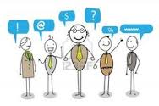
Messages vary in abstraction
Effective verbal messages include words that range widely in abstractness.
At times a general term may suit your needs best, at other times a more specific term serves better

Slide 10
Message meanings are in people
If you want to know the meaning of word love you turn to the dictionary “affection felt for a person, attraction, desire for person who arouse admiration”. The denotative meaning.
But if you want to know what Ali mean when he says “I'm in love “ you should turn to Ali to discover his meaning.

Slide 11
So meanings are not in words but in people.
As you change, the meaning in people is also change.
Example if someone said I love you created certain meaning but when you heard that the same word was said to three other people you drastically change the meaning you draw from these three words.

Slide 12
Messages meanings depend on context
According to the context the meaning of any verbal or nonverbal behavior is determined
In terms of verbal messages the same words may have different meanings when they occur in different context.
Example” how are you?’’ means “hello “ if you ask it in the street , but means different if you are in a hospital.
Cultural context is important in massages meanings.

Slide 13
Messages vary in inclusion
Do you include every present person in your messages?
Some messages are inclusive, they include all people present and they acknowledge the relevance of others.
You see messages of exclusion in the use of in- group language in the presence of an out –group member.
ex “ when doctors get together & discuss medicine, there's no problem, when there is someone who is not a doctor they often fail to adjust to that new person and continue talking about medicine.

Slide 14
Messages vary in inclusion- Cont.
Another form of exclusion using terms of own cultural group as universal terms that can be applied to everyone. Example using the mosque or church when the audience are from different religions.
Try to find ways to include everyone in the interaction by filling in relevant details for those who are unaware of topic or try to include them by drawing an analogy from their fields.
E.g. use alternative terms such as the word “place” of worship instead of use church or mosque, committed relationships instead of marriage.

Slide 15
CONFIRMATION & DISCONFIRMATION

Slide 16
Disconfirmation
It is the communication pattern in which you ignore someone's presence as well as that person's communications.
-Ex” this person & what he has to say are not important or not worth serious attention”.
This person’s contribution is unimportant or insignificant that there is no reason to concern yourself with them.

Slide 17
Rejection
Different than disconfirmation.
You disagree with the person.
You indicate your unwillingness to accept something the other says or does.
In disconfirmation however you deny the person’s significance; everything related to that person doesn’t count

Slide 18
Confirmation
It is the opposite communication pattern of disconfirmation.
You not only acknowledge the presence of the other person, but also indicate your acceptance of this person.

Slide 19
Examples disconfirmation rejection & confirmation
Why are you so angry? You get late last week. Stop screaming. I'll do what I want (Rejection).
You have a right to be angry. I should tell you that I will be late. ( Confirmation)
Deny the person significances. (Disconfirmation)

Slide 20
Sexism
Widespread expression of sexism is called sexist language.
Language that puts down someone because of his or her gender.
Guidelines for nonsexist ( gender free, gender neutral or fair) was developed. These guidelines concern the use alternatives to generic man person . (e.g. police officer instead of police man).
Generic he\she and his\here, (e.g. the average student is worried about his grade VS; the average student is worried about grades.
Talk plural so as to include sexes.

Slide 21
Sexism- cont.
Do not use sex role Stereotyping: the word you use often reflect a sex role bias
The assumption that certain roles or professions belong men and others belong to women shall be avoided:
E.g. when you refer to elementary school teacher as female and the college professor as a male.
E.g. When you refer to nurse as a female and to the doctor as a male
Use appropriate pronoun. e.g. female nurse ,male doctor or vice versa

Slide 22
Conceptual distortion (تحريف)
Using verbal messages might be susceptible to conceptual distortion which is:
Mental mistakes
Misinterpretations or
Reasoning fallacies (misjudgment)
Therefore avoiding these distortions requires more critical realistic analysis to improve your own use of verbal messages

Slide 23
General principles of verbal messages
To explore conceptual distortion we examine three general principles of verbal messages:
Messages symbolize reality but are not the reality itself
Messages can express facts and /or inferences but may not always make the necessary distinction between these two types of statements
Messages can obscure important distinctions

Slide 24
Messages symbolize reality, it's not reality itself.
Consider the following to understand this first principle:
Have you ever react to the way something was labeled or described rather than the actual item?
Have you ever bought something because of its name rather than because of the actual object?

Slide 25
Messages symbolize reality, it's not reality itself- Cont.
Intentional orientation refers to our tendency to view people, objects and events in a way they are talked about or labeled.
E.g. trade marks ,cosmetic or major stores …
E.g. Sally is labeled as uninteresting , you respond intentionally and evaluate her as uninteresting.
Extensional orientation: tendency to look first at actual people ,object ,and event and only afterwards at their labels.
keep your mind free of any preconceived ideas.

Slide 26
A related distortion is to forget that language symbolize only a portion of reality never the whole.
So a person might be in one of the two patterns:
Allness:
When you assume that you can know all or say all about anything.
This is what you think but the reality is: You never see all of anything, you never experience anything fully, you see a part then conclude what the whole is like.
Nonallness :
When you recognize that language symbolizes only apportion of reality not the whole. In this situation whatever a person says regardless of what it is or how extensive you believe, it is only a part of the story.

Slide 27
Messages express facts & inferences
There are two types of statements
Factual statement : A statement that you make only after you observe the person or event and limited to what you have observed. E.g. “She is standing on the stairs”
Inferential statement: A statement that can be made without observation or go beyond what you have observed; It is a guess. E.g. “She is feeling uncomfortable on the stairs”
Barriers to clear thinking can be created when inferences are treated as facts a tendency called : “Fact- inference confusion”

Slide 28
Messages express facts & inferences- Cont.
Lying: Is an intentional inferential pattern in which one person intends to mislead another by verbal and nonverbal communication
Why lying?
Lie to make another person feel good
Lie to enable another person to save face
Lie to get what you deserved but couldn't get any other way.
Lie to get your self out of an unpleasant situation.

Slide 29
Messages can obscure(يحجب ) distinction
Messages can obscure distinctions both by generalizing about people or events that are covered by the same label but are really quite different.
When you allow the general term to obscure the specific differences, you are into a pattern called indiscrimination

Slide 30
Indiscrimination
It is the failure to distinguish between similar but different people , objects or events.
It occurs when you focus on the classes and fail to see that each phenomenon is unique and needs to be looked at individually.
Example: group together teachers, students politicians, such terms lead you to focus on similarities, at the same time the term divert attention away from the uniqueness of each person
This kind of misevaluation is the heart of stereotyping
Stereotyping is: A fixed mental picture of a group that is applied to each individual in a group without regard to his or her unique qualities

Slide 31
Indiscrimination- Cont.
To treat indiscrimination use the antidote which is the index
Index : is mental subscript identifies each individuals as an individual even thought both may covered by the same label
Avoid stereotypes, e.g:
Americans are intelligent.
African American are criminals
Muslims are terrorists

Slide 32
Messages can obscure(يحجب ) distinction- Polarization
Using Polarization in Messages can obscure distinction
Polarization is:
The tendency to look at the world in terms of opposites and to describe it in extremes
Referred to as fallacy of either black or white
There is a tendency to view only the extremes and categorize people objects and events in terms of those polar opposites
Example: extremes such as:
Good, Bad Positive, Negative Happy, Unhappy
However the middle ground terms that reflects the situation in the middle are few . This creates a problem when we use the opposites in inappropriate situations.
For example some times I am not good but I am not bad however I am in between.

Slide 33
Nonverbal Messages

Slide 34
Definition of nonverbal communication
It define as communication without words by using several signals like posture , smile or frown (عبوس),widen your eyes , touch someone, raise your vocal volume or even say nothing .

Slide 35
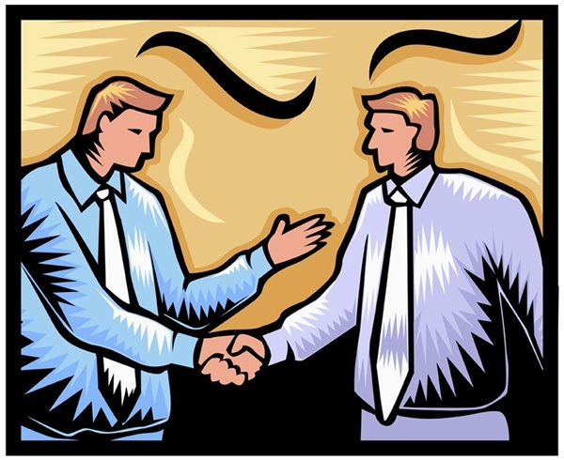
Good Body Language is Essential for Good Communication

Slide 36
The Benefits of competency in non verbal communication
1.The greater your ability to encode and decode non-verbal signals, the higher your popularity and psychological wellbeing are likely to be.
Encoding and decoding are highly correlated: if you are good at expressing yourself nonverbally then you are likely to be good at reading the nonverbal cues of others.

Slide 37
The competency in non verbal communication has two benefits- Cont.
2. The greater your nonverbal skills, the more successful you are likely to be at influencing and deceiving others.
In other words skilled nonverbal communicators are highly persuasive. This persuasive power can be used to help or support others or it can be used to deceive and fool.

Slide 38
The function of nonverbal messages
To understand the functions of nonverbal messages you should look at the Integration of nonverbal & verbal messages. It can be explained as:

Slide 39
Integration of nonverbal and verbal messages
1) Serves to accent or emphasize( e.g. raise your voice to underscore a particular word or phrase ,bang your fist on the desk to stress your commitment)
2) Complement or add hints of meaning not communicated by your verbal messages( e.g. smile while telling story to suggest that you find it funny).
3) Regulate: to control or indicate your desire to control (e.g. to make a hand gesture to indicate that you want to speak).

Slide 40
Integration of nonverbal and verbal messages- Cont.
4) repeat: restate the verbal messages nonverbal ( e.g. raised your eye brows , is that right?).
5) substitute: replace the verbal messages with nonverbal( e.g. you can signal “OK” with a hand, shake your head to indicate no ).
6) contradict verbal messages with nonverbal movement ( e.g. crossing your fingers” when you are lying).

Slide 41
Nonverbal communication Functions
1.Forming and managing impression about person body, skin color, dress eye contact… .Also it reflect credibility of person likeability ,attractiveness and dominance or power .
2.Forming and defining relationship ( you communicate nature of relationship) as holding hands or dressing alike .
3.Structuring conversation and social interaction by nodding head toward another person giving the signal that you give this person the turn to speak.

Slide 42
Functions Cont….
4.Influence and deception (gestures that explain what you are saying). Deception the ability to deceive ,to lie or to mislead another person to thinking something is true when its false.
5.Emotional expression( nonverbal expressions about emotion e.g. happiness, sadness.).Use the non-verbal communication with unpleasant messages.

Slide 43
The channels of nonverbal messages.
1)Body messages.
2)Face messages.
3) Eye messages .
4) Spatial messages
5) Artifactual messages
6) Touch messages
7) Silence messages
8) Time messages
9) Smell messages

Slide 44
Body messages- Body movements
Major types of body movements:
1- Emblems are body gestures that directly translate into words or phase ( e.g. “OK” for good job or “V” for victory).
2- Illustrators ( e.g. point your arm to the left means turn to the left).
3- Affect displays ( movements of the face e.g. body tension or relaxation.).

Slide 45
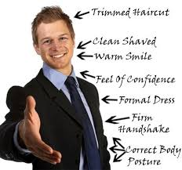

Slide 46
Facial messages
It communicate the eight primary emotions( happiness, surprise, fear, anger, sadness, disgust, contempt (dislike), interest).
Cultural display rules…
e.g. American students displayed facial expression but Japanese are not.
e.g. Japanese women aren't supposed to reveal broad smiles, they hide their smile.

Slide 47
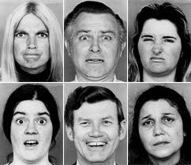
Facial messages

Slide 48
Facial management techniques
Used to communicate feelings to achieve the effect you want.
Help people to display emotion In socially acceptable manner and polite interaction
  Intensify or exaggerate feeling: intensify or minimize feeling…cover up your joy in presence of friend who received bad news
  Neutralize or cover or hide a feeling (cover up your sadness to keep from depressing others)
  Mask or replace his expression of one emotion for another…express happiness in order to cover up your disappointment
  Simulate…express an emotion you don’t feel..

Slide 49
Eye messages
These messages depend on duration, direction & quality .
*purposes of eye contact :-
Request for feedback through and after conversation .
Nature of relationships ,positive or negative relationship.
Eye contact enable you to psychologically lessen the physical distance between your self and other person .

Slide 50
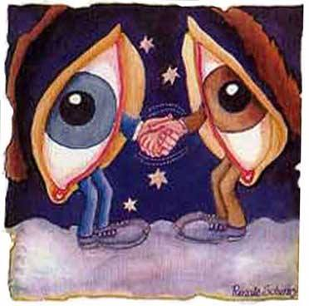
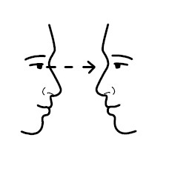
Eye Messages

Slide 51
Eye messages – Cont.
Eye avoidance purposes:
-Help others to maintain their privacy. You do this when you see couple arguing in public.
It is a signal of lack of interest
Block unpleasant stimuli such as a scene in a movie
To heighten other sense such as close your eyes while listening to Quran to feel the meanings

Slide 52
Space messages ( spatial)
Proxemic distances:
1- Intimate distance ( actual touching to 18 inches e.g. you feel other breath).
2- Personal ( 18 inch to 4 feet ).
3- Social (4to 12 feet e.g. interpersonal business).
4- Public 12-25 feet or more protects you. At this distance you can take defensive action if threatened.

Slide 53
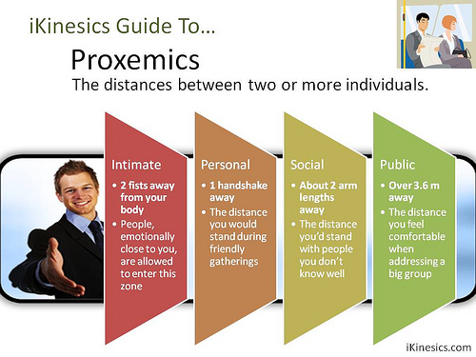

Slide 54
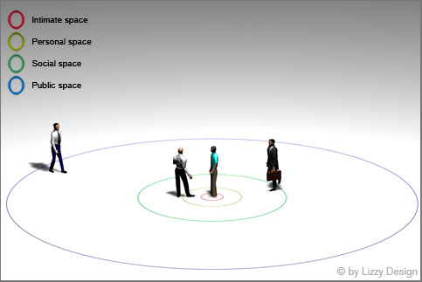

Slide 55
Artifactual messages
They are messages that are conveyed through objects:
Color: wearing certain colors send different messages.
Clothing send a message who you are at least in a part ( e.g. Person with a tie vs. person with jeans )
Body adornment ( decoration) Make up, Tattoos
Jewelry: some jewelry is a form of culture display
Space decoration: the way you decorate your private space speaks about you.

Slide 56
Touch Messages
It is primitive (simple, basic) form of communication that develops before other senses
Major meanings of touch:-
1- Positive emotion (communicate positive feelings such as support, appreciation) .
2- Playfulness (our intention to play) .

Slide 57
Touch Messages- Cont.
3- Control (touch may direct the behaviors attitudes or feelings of the other person.
4- Ritual: for greetings or departures ( e.g. shaking hands to say goodbye ).
5- Task- relatedness: occurs while you are performing some functions ( e.g. helping someone out of car).

Slide 58
Touch messages- Cont.
Touch avoidance
e.g. touch and self disclosure are intimate form of communication.
e.g. close self personality are touch avoidance.
e.g. older people have higher touch avoidance for opposite sex persons than do younger people.
e.g. men avoid touch men but women may and do touch other women (according to the cultural perspective)
Women have higher touch avoidance for opposite sex touching than men.

Slide 59
Silence messages.
Like words and gesture, silence too communicate important meanings and serves important main functions:-
1- Time to think: allows the speaker to formulate and organize his or her verbal communication. It also seems to prepare the receiver for the importance of these messages
2- to hurt others: After a conflict one or both individuals may remain silent as a kind of punishment. It may also take the form of refusal to acknowledge the presence of another person as in disconfirmation.

Slide 60
Silence messages functions Cont…
3- Response to personal anxiety , shyness or threats. By remaining silent you preclude( prevent) the chance of rejection.
4- to prevent communication of certain messages. In conflict situations silence sometimes used to prevent certain topics from surfacing( developing) and to prevent both parties from saying things they may later regret
5- to communicate emotional response: determination to be uncooperative or defiant( disobedient)

Slide 61
Paralanguage messages
Refers to how you say something.
* Pitch.
* Voice qualities.
* Rate ( speed).
* Volume & rhythm.
Purpose :
Judgments about people e.g. evaluation of emotion status …paralanguage of fear and anxiety can be distinguished.
Judgments about communication effectiveness, fast speed speakers are more persuasive person than slow speed speakers.

Slide 62
Time messages.
The study of temporal communication, known technically as “Chronemics” concerns with the use of time, how you organize it react to it and communicate messages through it.
Example: Psychological time.
The emphasis you place on the past, present or future.
Past: you have special reverence for the past, you relieve the old times and regard the old methods as the best, the wisdom of yesterday is applicable also to today and tomorrow.
Present: live now not for tomorrow.
Future: look forward to live in the future, example study hard and ignore luxuries because you are preparing for the future.

Slide 63
Smell messages( olfactory communication)
It is extremely important in a wide variety of situations and now big business. e.g. smell of lemon mean health freshness.
Messages that scent seems to communicate:
Attraction messages: people use perfumes to increase their attractiveness.
Taste messages: without smell, taste would be severely impaired
Memory messages: smell is powerful memory aid.
Identification messages like tooth paste and kids can identify the smell of brother t-shirt.

Slide 64
Culture and nonverbal messages
Each culture has their own cultural trends and meaning for nonverbal messages, like meaning of signals ,colors, touching ,time , even silence. E.g. yellow in china signify wealth and authority…

